Slide 1
A Statistical Analysis of Anomalous Fluctuations of Energy Transport in a Filamentary Magnetized Plasma
Presentation created by Cassandra Mckenna
Research collaborators: R. D. Sydora[1], S. Karbashewski[1]
Research supported by NSERC USRA and the University of Alberta, Department of Physics

Slide 2
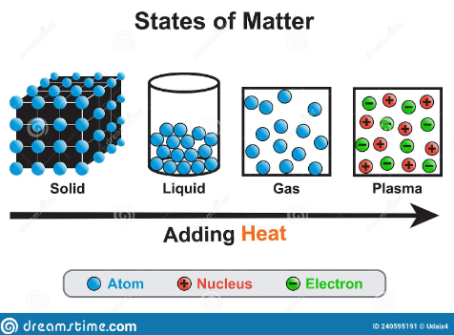
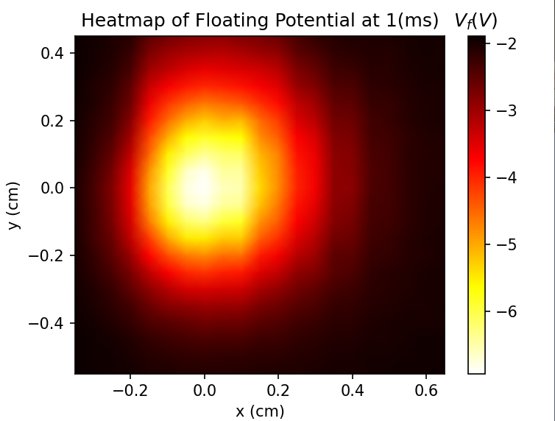
What is a Plasma in 30 Seconds.
A plasma can be idealized as a gas but with the electrons separated from the nucleus (electrons and alpha particles for helium)
A magnetized plasma is a plasma with an external magnetic field.
Filaments in plasmas are caused by shooting hot electrons, this creates a temperature filament similar to your stove!

Slide 3
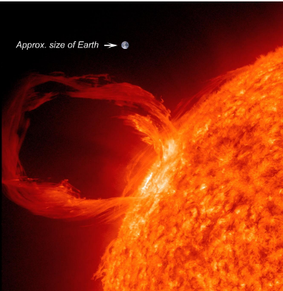
Motivation to Study Plasmas:
Energy-transport models are incomplete for filaments in plasmas.
Very important to understand energy-transport as many astrophysical plasma have plasma filaments which release huge amounts of energy.
By creating a model, we can correlate energy-transport relationships to physical properties of the plasma. (work backwards).
Current models disagree with each-other and don’t fully explain experimental results, by investigating energy-transport relationships more thoroughly, we aim to create a model in future work.

Slide 4
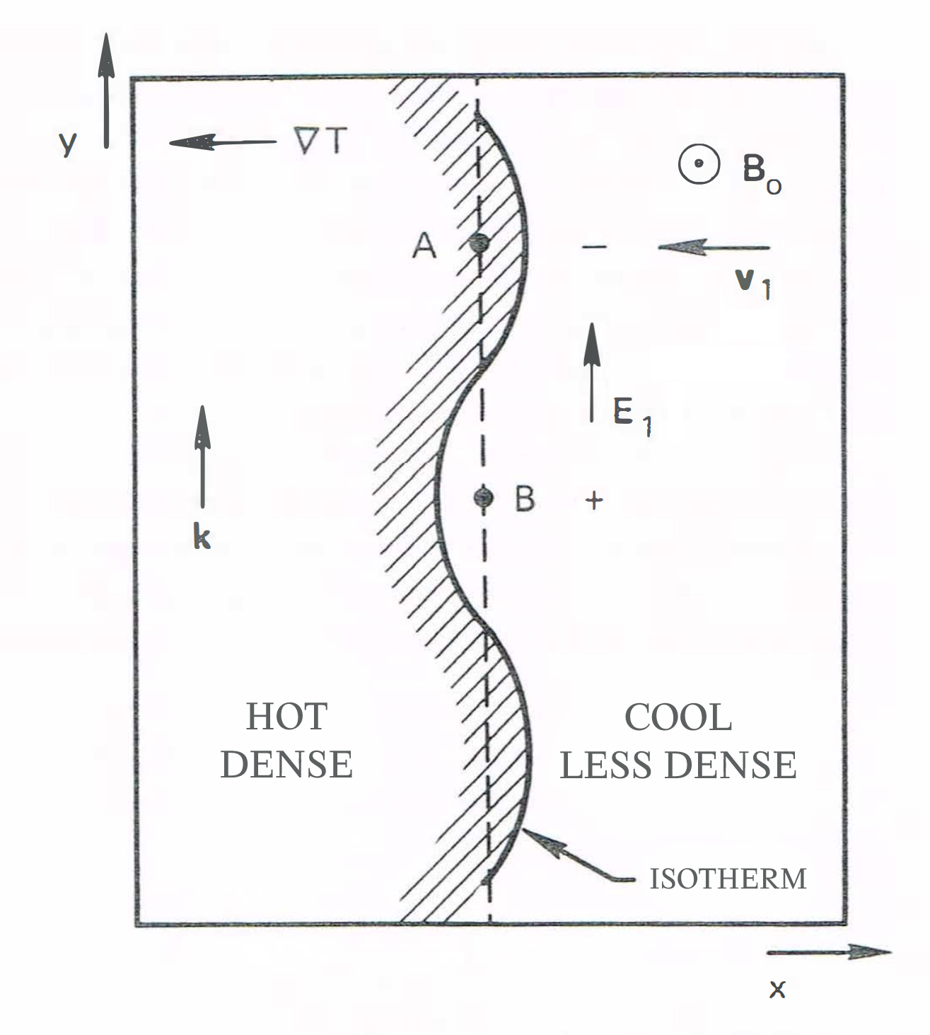
How do Plasma’s Transport Energy
In our filament, we have local hot and cold zones, which makes the electrons diffuse to different lengths.
If our filament was homogenous, we would expect the line connecting A and B to be the isotherm.
Between A and B there is a difference in the temperature and electron density, resulting in a potential difference.
Oscillating
Electric
Field

Slide 5
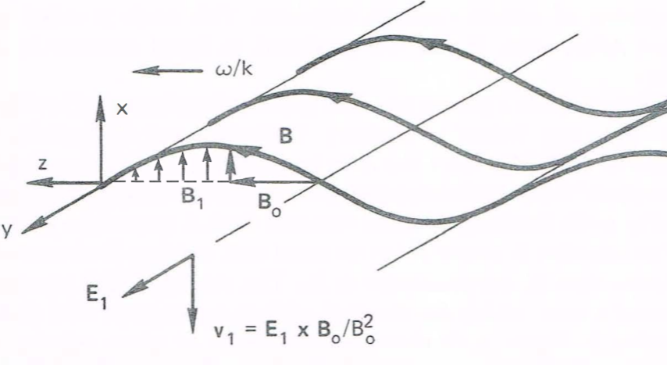
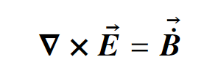

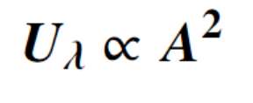

Drift-Alfven Waves
Due to electric field oscillating (ie switches up facing to down facing in a wave), the magnetic field also oscillates in the x direction.
Since we have an external magnetic field, adding these vectors we get a wave!
Since plasmas aren’t just electrons, the positive ions rapidly accelerate due to the our fields and overshoot, leading to exceptionally large increases in amplitude.

Slide 6
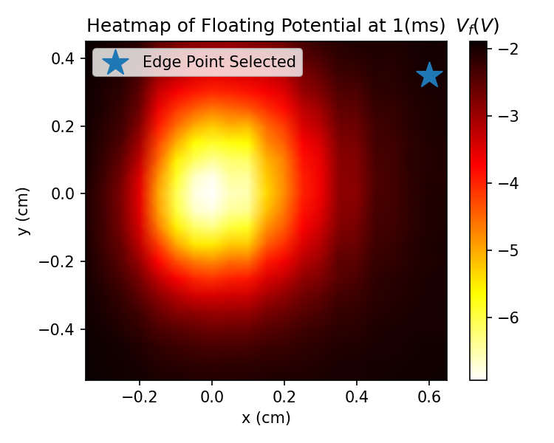
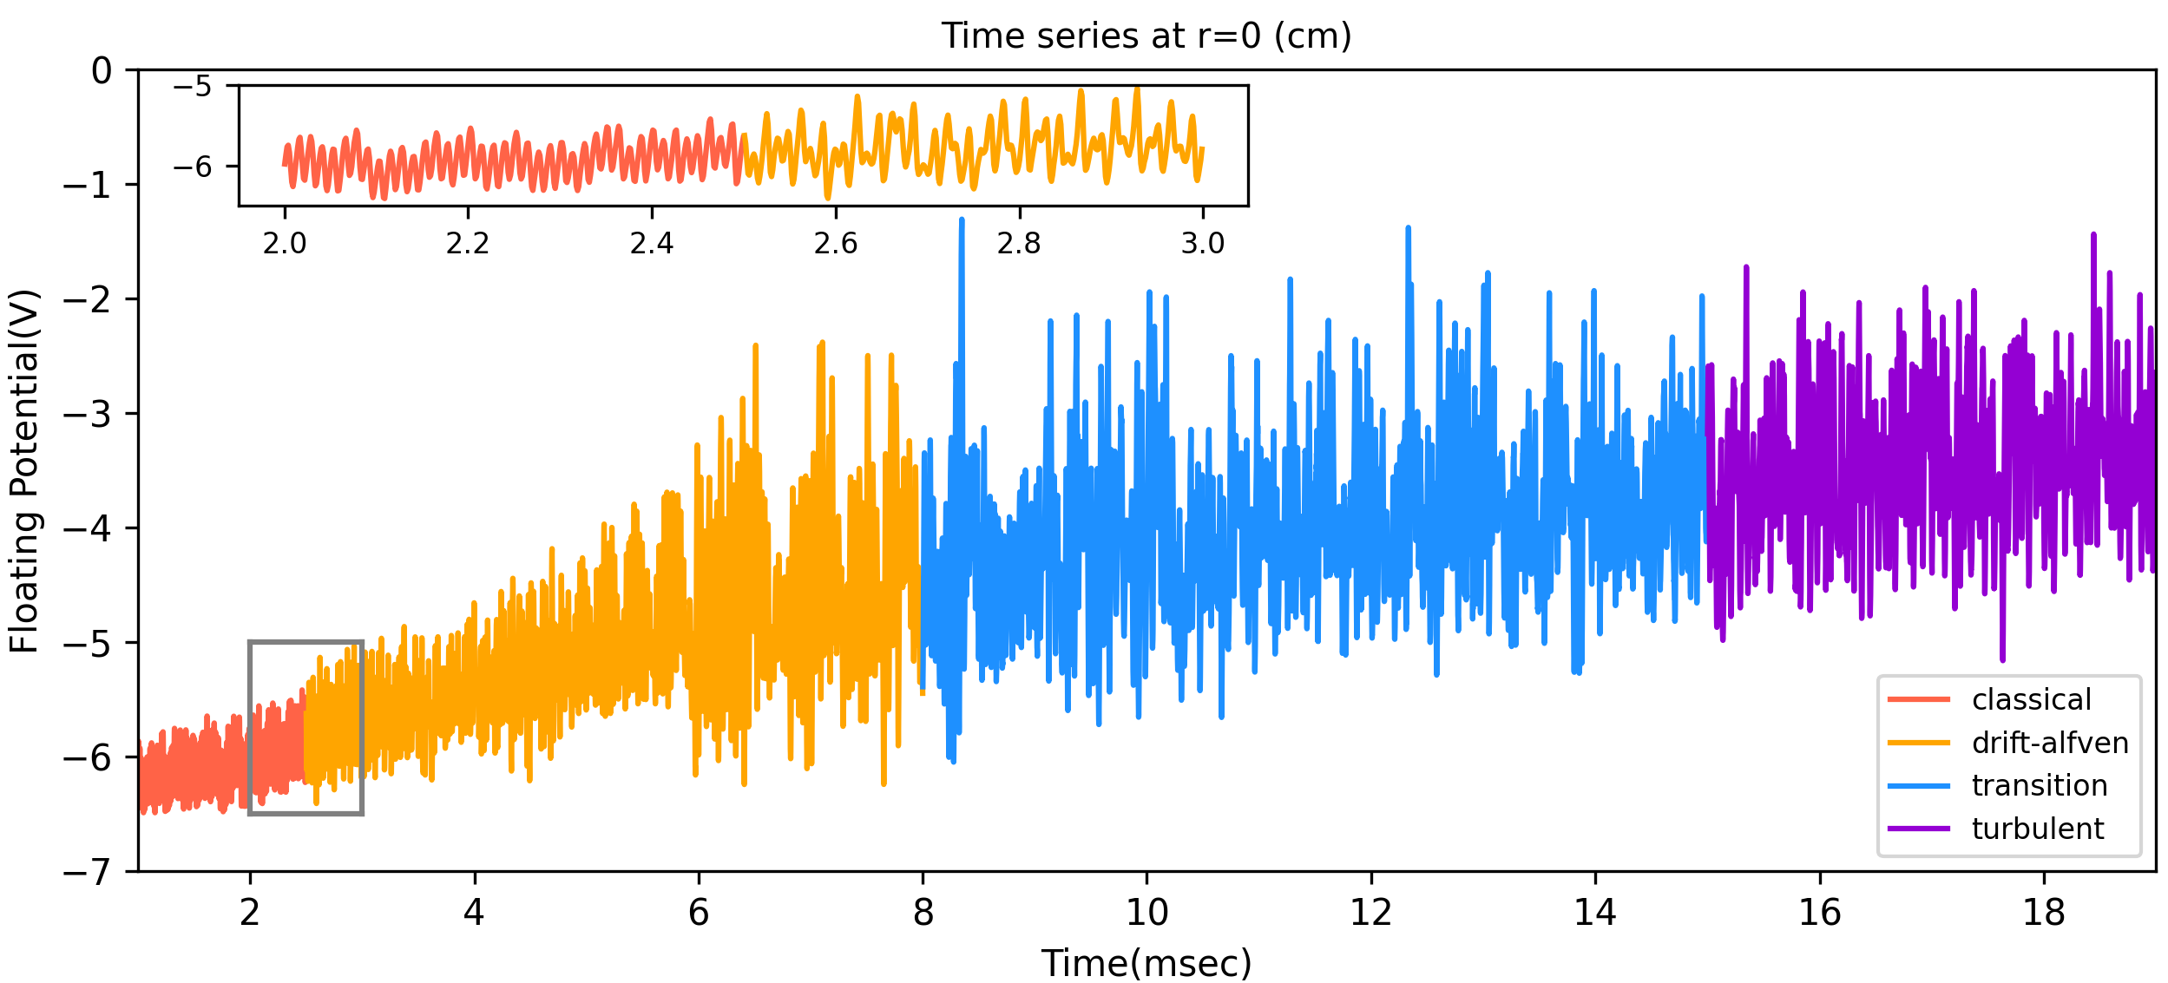
Characterizing our Plasma Through Time
Selecting a point and analyze the time series of its voltage with respect to the edge of the plasma column.
By choosing a point far outside the filament, the predominate energy-transfer will come from waves.
When creating a time series at our select point we can see there are four distinct windows of activity.
Classical phase (red) is electrons move away and
energy is transferred through collisions, the
yellow is when Alfven waves start and ions
increase the amplitude at ~6ms. Waves are the
now predominate energy-transport mechanism. The
blue is simply a dampening phase and purple is when
our plasma becomes chaotic.

Slide 7
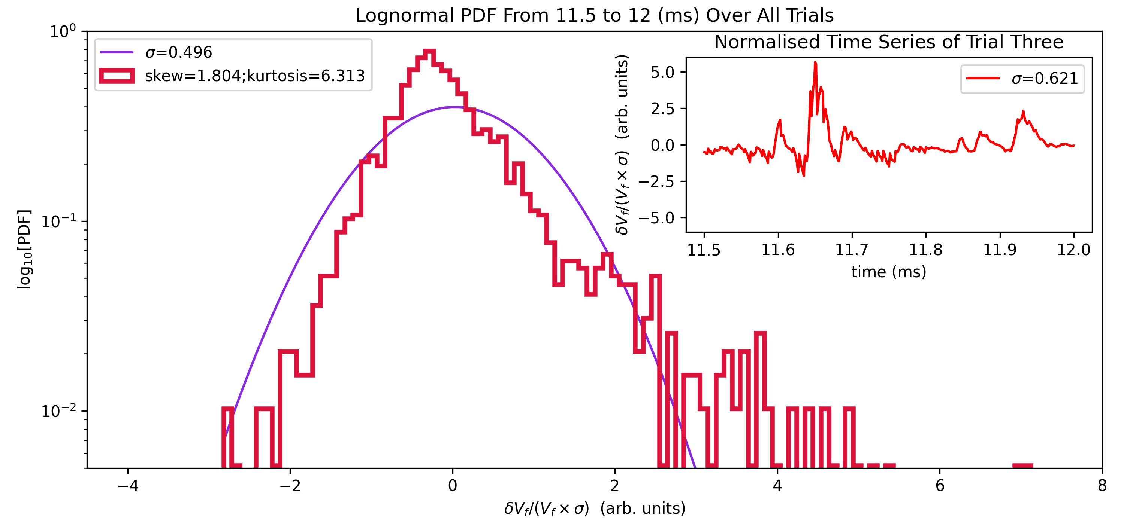
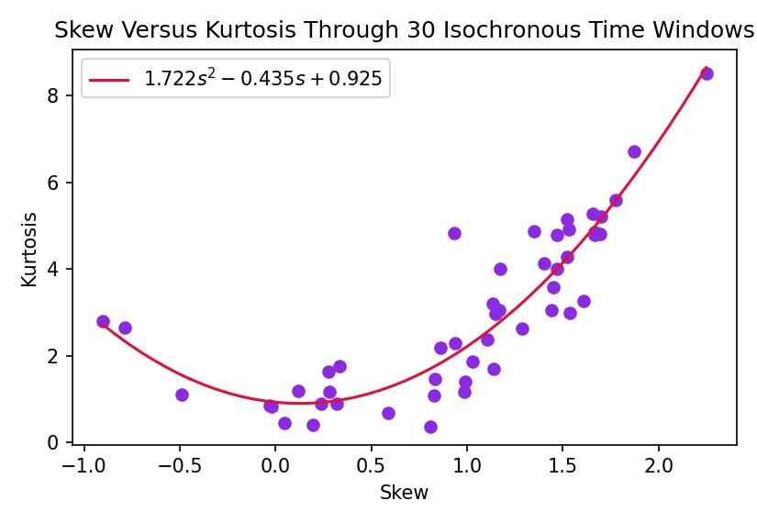
Fluctuations Through Temporal Evolution
Plotting histograms in small windows of the time-series and plot the change in potential divided by the magnitude.
Large Kurtosis relates to the number of outliers, in our case bursts, skewness relates to how gaussian the outliers are.
By finding the skew-kurtosis of histograms spanning our time-series, we can characterize energy-transport(quadratic)
By characterizing our relationship and creating a model, we can then find a physical interpretation of the relationship!
Kurtosis
Skew

Slide 8
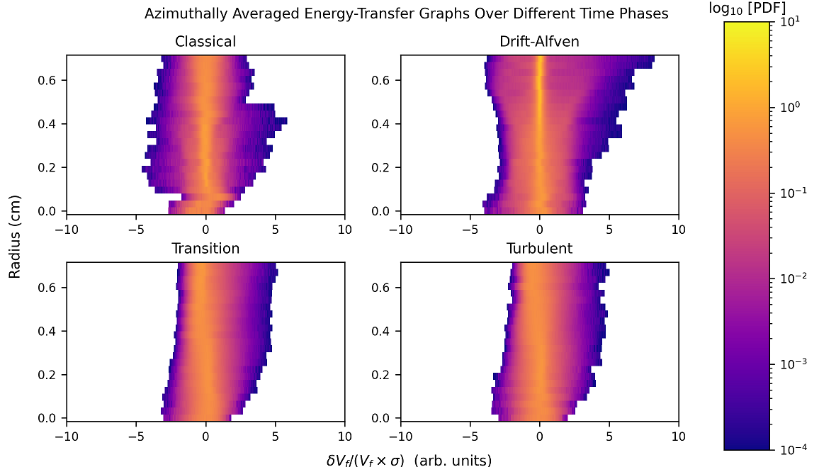
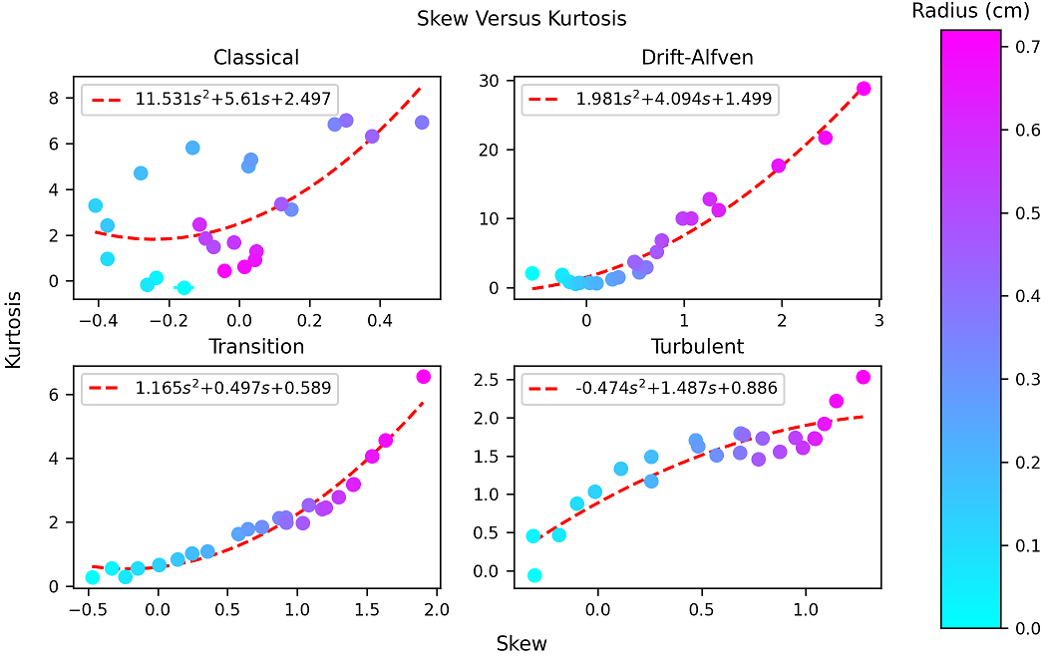
Fluctuation Through Spatial Evolution
Plotting histograms through radial evolution (set time windows) rather than a time series, we can see spatial evolution.
The classical phase is random(collision-dominated).
In the Drift-Alfven phase at high radii, like the last slide, there is a large skew-kurtosis relationship indicating waves.
The transition phase is dampened (smaller quadratic coefficient), however the turbulent phase is a different shape!
Kurtosis
Skew

Slide 9
Take-aways
By charazterizing relationships between skew-kurtosis in both spatial and temporal evolution, we can now create a model which can lead to a physical interpretation of the skew-kurtosis relationship.
By understanding skew-kurtosis relationships, we can then work backwards and see what uncharacterized physical processes are happening in astrophysical plasma (example: blackhole accretion discs[1], or the solar corona[2]).
Questions?
2) Beaufume, P. (1992). Anomalous energy transport in hot plasmas: solar corona and Tokamak (FRCEA-TH--365). France

